Slide 1
Heading data update
Y
N
GNSS fix type >= 1 & Valid
Send true heading
Item | byte
hins->fix_type | 1 | uint8_t
hins->valid_flag_da | 2 | uint16_t
hins->heading_da | 4 | float
imu_heading | 4 | float
g_heading_offset | 4 | float
hins->gps_tow | 8 | double
Y
Update heading offset

Slide 2
FOG AHRS streaming start
dual Ant. Fix type =2 ?
FOG AHRS streaming stop
wait 5 sec
dual Ant. ==2
&&
Valid flag = 1 ?

Slide 3
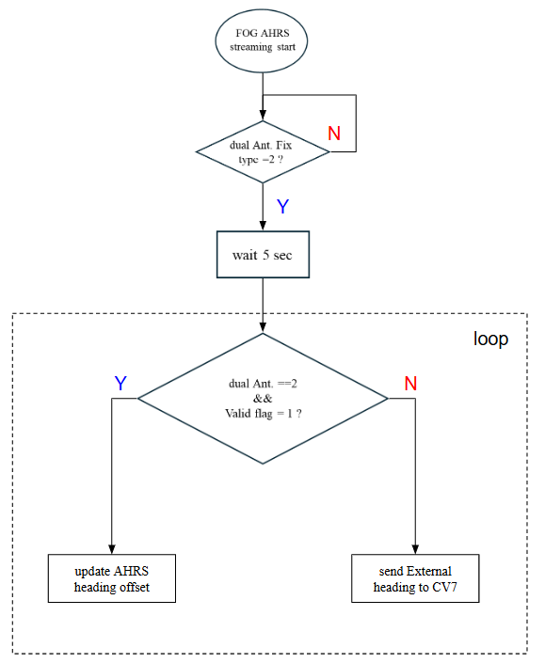

Slide 4
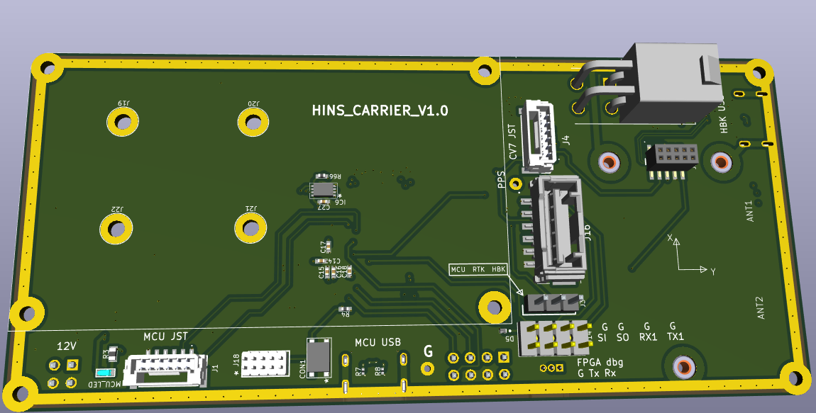
PCB 上 IMU 與 CV7 坐標軸方向相同，需先一起旋轉至 case/body frame

